Slide 1


CS-446: Information Systems Security
Lecture # 16: Kerberos
Prof. Dr. Sufian Hameed
Department of Computer Science
FAST-NUCES

Slide 2
Kerberos
Authentication service developed as a part of MIT’s Athena project
Provides centralized private-key third-party authentication in a distributed network
allows users access to services distributed through network
without needing to trust all workstations
rather all trust a central authentication server
Current version in use: 5
Notes:
Kerberos is an authentication service developed as part of Project Athena at MIT, and is one of the best known and most widely implemented trusted third party key distribution systems.
Kerberos provides a centralized authentication server whose function is to authenticate users to servers and servers to users. Unlike most other authentication schemes, Kerberos relies exclusively on symmetric encryption, making no use of public-key encryption. Two versions of Kerberos are in common use: v4 & v5.

Slide 3
Kerberos Overview
A basic third-party authentication scheme
Have an Authentication Server (AS)
users initially negotiate with AS to identify himself
AS provides a non-corruptible authentication credential (ticket granting ticket TGT)
Have a Ticket Granting server (TGS)
users subsequently request access to other services from TGS on basis of users TGT
Notes:
The core of Kerberos is the Authentication and Ticket Granting Servers – these are trusted by all users and servers and must be securely administered. The protocol includes a sequence of interactions between the client, AS, TGT and desired server.

Slide 4
Kerberos Dialogue
Obtain ticket granting ticket (TGT) from AS
once per session
Obtain service granting ticket from TGT
for each distinct service required
client/server exchange to obtain service
on every service request
Notes:
The full Kerberos v4 authentication dialogue is shown in Stallings Table 14.1, divided into the 3 phases shown above. The justification for each item in the messages is given in Stallings Table 14.2.

Slide 5
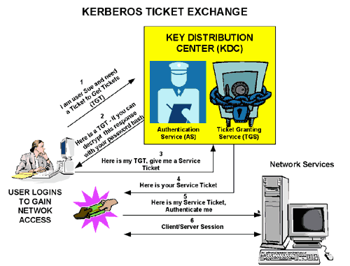
Kerberos Basic Overview
*technet.microsoft.com
Notes:
Stallings Figure 14.1 diagrammatically summarizes the Kerberos v4 authentication dialogue, with 3 pairs of messages, for each phase listed previously.

Slide 6
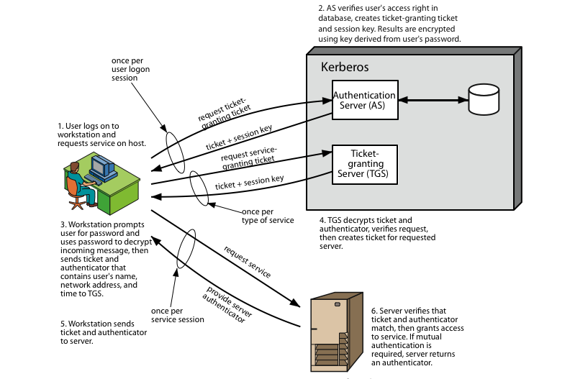
Kerberos Elaborated
Notes:
Stallings Figure 14.1 diagrammatically summarizes the Kerberos v4 authentication dialogue, with 3 pairs of messages, for each phase listed previously.

Slide 7
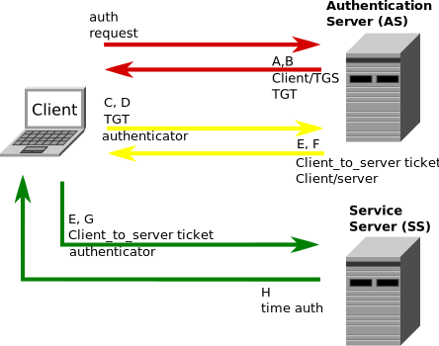
Kerberos Protocol Description
1. User Client-based Logon
A user enters a username and password on the client machines.
The client performs a one-way function (hash usually) on the entered password, and this becomes the secret key of the client/user.
AS and TGS are the same

Slide 8
Kerberos Protocol Description
2. Client Authentication
Client sends user ID (lets assume A) to the AS in cleartext.
AS generates the secret key by hashing the password of the user found at the database (K_{A}).
AS sends back the following two encrypted messages to the client:
A: Client/TGS Session Key (S_{A}).
B: Ticket-Granting-Ticket (which includes the client ID, client network address, ticket validity period, and the client/TGS session key) encrypted using the secret key of the TGS i.e B →TGT_{A} = K_{TGS}(clientID, ……, S_{A}).
K_{A}(A, B) → K_{A}(S_{A}, TGT_{A})
At this point, the client has enough information to authenticate itself to the TGS.
Notes:
The client sends a cleartext message of the user ID to the AS requesting services on behalf of the user. (Note: Neither the secret key nor the password is sent to the AS.) The AS generates the secret key by hashing the password of the user found at the database (e.g. Active Directory in Windows Server).
The AS checks to see if the client is in its database. If it is, the AS sends back the following two messages to the client:
A: Client/TGS Session Key encrypted using the secret key of the client/user.
B: Ticket-Granting-Ticket (which includes the client ID, client network address, ticket validity period, and the client/TGS session key) encrypted using the secret key of the TGS.
Once the client receives messages A and B, it attempts to decrypt message A with the secret key generated from the password entered by the user. If the user entered password does not match the password in the AS database, the client's secret key will be different and thus unable to decrypt message A. With a valid password and secret key the client decrypts message A to obtain theClient/TGS Session Key. This session key is used for further communications with the TGS. (Note: The client cannot decrypt Message B, as it is encrypted using TGS's secret key.) At this point, the client has enough information to authenticate itself to the TGS.

Slide 9
Kerberos Protocol Description
3. Client Service Authorization
For Service request the following messages are sent to TGS:
C: Composed of the TGT_{A} and service ID.
D: Authenticator (client ID and the timestamp encrypted with S_{A}) i.e S_{A}(timestamp, ClientID)
TGS decrypts D (Authenticator) and sends the following two messages to the client after encryption:
E: Client-to-server ticket (which includes the client ID, client network address, validity period and Client/Server Session Key) encrypted using the service server's secret key i.e. CTS_{A} = K_{SS} (clientID, ……, SS_{A}).
F: Client/Server Session Key i.e SS_{A}.
S_{A}(E, F) → S_{A}(CTS_{A}, SS_{A})
Notes:
When requesting services, the client sends the following two messages to the TGS:
Message C: Composed of the TGT from message B and the ID of the requested service.
Message D: Authenticator (which is composed of the client ID and the timestamp), encrypted using the Client/TGS Session Key.
Upon receiving messages C and D, the TGS retrieves message B out of message C. It decrypts message B using the TGS secret key. This gives it the "client/TGS session key". Using this key, the TGS decrypts message D (Authenticator) and sends the following two messages to the client:
Message E: Client-to-server ticket (which includes the client ID, client network address, validity period and Client/Server Session Key) encrypted using the service's secret key.
Message F: Client/Server Session Key encrypted with the Client/TGS Session Key.

Slide 10
Kerberos Protocol Description
4. Client Service Request
Upon receiving messages E and F from TGS, the client has enough information to authenticate itself to the SS. The client connects to the SS and sends the following two messages:
E: CTS_{A} = K_{SS} (clientID, ……, SS_{A})..
G: A new Authenticator (client ID and the timestamp encrypted with SS_{A}) i.e SS_{A}(timestamp, ClientID)
SS decrypts the Authenticator and sends the following message:
H: SS_{A} (timestamp +1).
The client decrypts the confirmation using the Client/Server Session Key and checks whether the timestamp is correctly updated. If so, then the client can trust the server and can start issuing service requests to the server.
The server provides the requested services to the client.

Slide 11
Replicated KDCs (AS + TGS)
Problem: The KDC is a bottleneck
If the KDC is down, it will not be possible to access remote resources (single-point-of-failure)
If the KDC is overloaded, the whole network performance will be affected
Solution: Replicated KDCs
Multiple, interchangeable KDCs
All share the same master KDC key
Have identical databases
Use of one master copy to keep all KDCs identical
All updates are done only on this master copy
All other KDCs are read-only slaves which update from the master copy (periodically or initiated by a human)
If the master copy fails, no new entries can be created, but authentication of principals still is possible with read-only KDCs
Notes:
A full-service Kerberos environment consisting of a Kerberos server, a number of clients, and a number of application servers is referred to as a Kerberos realm. A Kerberos realm is a set of managed nodes that share the same Kerberos database, and are part of the same administrative domain. If have multiple realms, their Kerberos servers must share keys and trust each other.

Slide 12
Realms
Remaining problem with replicated KDCs: consider several companies, banks, governments, ... in a big network:
Whoever manages the KDC can access all user master keys
It is hard to find an organization to manage the KDC that anybody would trust
Replicated KDCs are physically located at the different stakeholders’ sites, and all of them need to be secure and trusted by all stakeholders
Solution: split network into realms
Each realm has its own trusted master KDC database
typically a single administrative domain
KDCs in the same realm are equivalent
KDCs of different realms are different:
Different KDC master key
Different principals (and also keys)
Notes:
A full-service Kerberos environment consisting of a Kerberos server, a number of clients, and a number of application servers is referred to as a Kerberos realm. A Kerberos realm is a set of managed nodes that share the same Kerberos database, and are part of the same administrative domain. If have multiple realms, their Kerberos servers must share keys and trust each other.

Slide 13
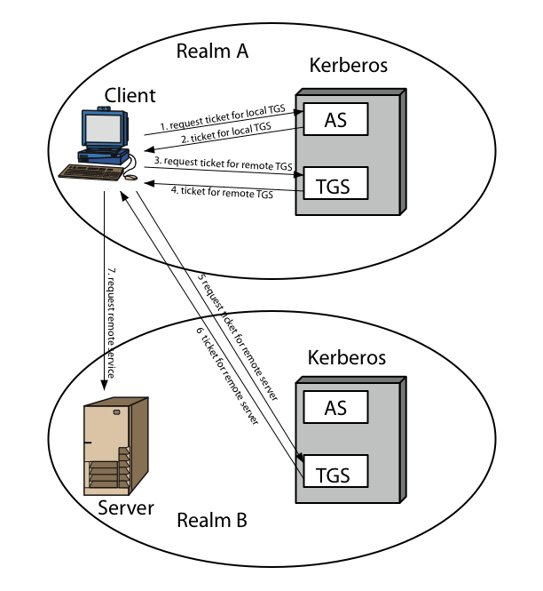
Kerberos Realms
Notes:
Stallings Figure 14.2 shows the authentication messages where service is being requested from another domain. The ticket presented to the remote server indicates the realm in which the user was originally authenticated. The server chooses whether to honor the remote request. One problem presented by the foregoing approach is that it does not scale well to many realms, as each pair of realms need to share a key.

Slide 14
Acknowledgements
Material in this lecture are taken from the slides prepared by:
Prof. Dr. Spaniol (RWTH-Aachen)
Network Security Essentials by William Stallings
And
http://en.wikipedia.org/wiki/Kerberos_(protocol)

